Slide 1


Data Analysis in Sakila Database
By Subhadwip manna
Under guidance of Dr. Aakansha Gupta

Slide 2



Introduction
MovieOnRent is a movie rental store with a vast collection of movies in DVDs and blue ray disc formats. The management wants to analyze the data to understand what kind of movies and actors are often rented.
This analysis would help stock up the inventory of movies to improve their business.
Here we have to use SQL language to retrieve required the data to perform the project by answering the questions in the upcoming slides.

Slide 3

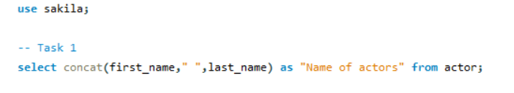
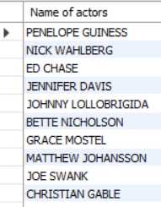
Result :
By merging first name and last name using concate clause we get full name.
There are 200 actor in the data

Slide 4
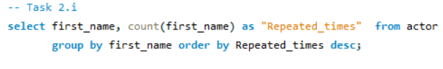

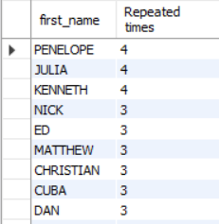
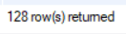
Result :
There are 128 different first names where Penelope, Julia and Kenneth are most common first names and repeating 4 times.

Slide 5
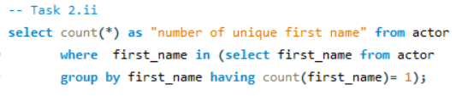
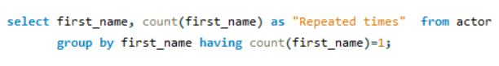
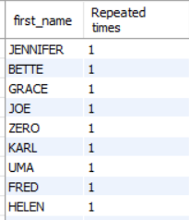
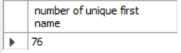
Result :
Result :
There are 76 unique first names.

Slide 6
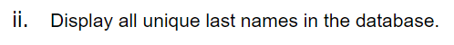
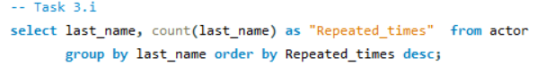
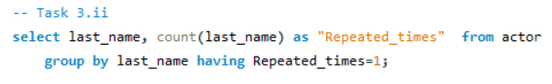
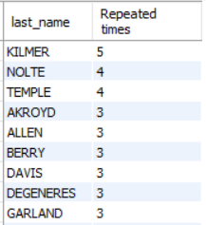
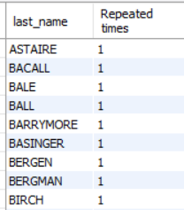

Result :
Result :
There are 121 different last names where Kilmar is most common last names and repeating 5 times.
There are 66 unique last names.

Slide 7

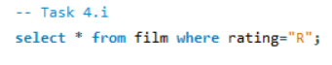
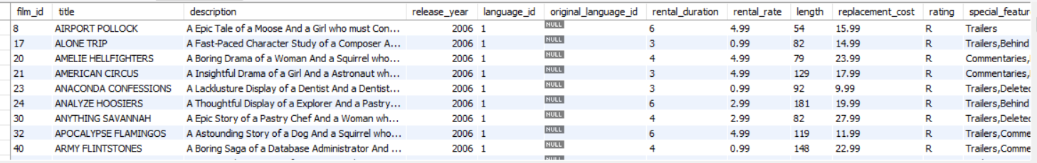

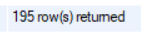
Result :
There are 195 movies which are not suitable for audience under 17 years of age.

Slide 8
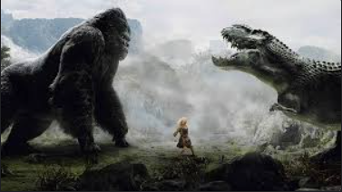
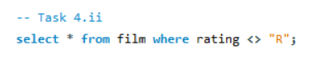
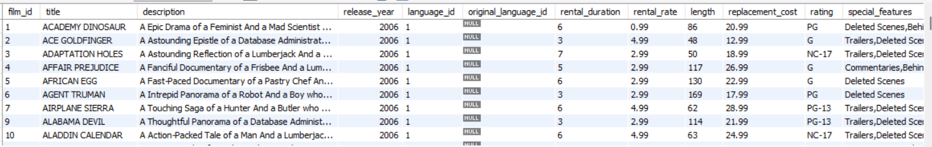


Result :
There are 805 movies which are not rated as “R”

Slide 9

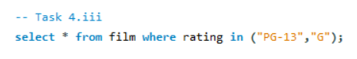
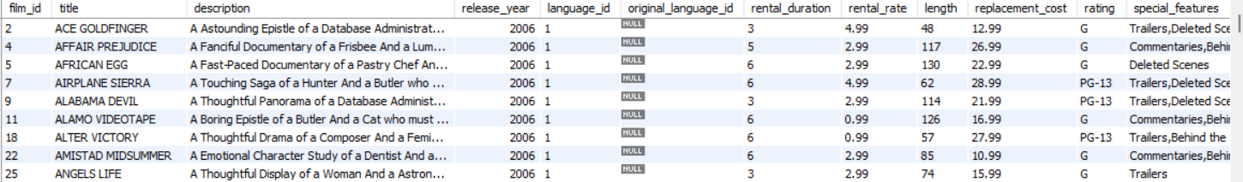

Result :
There are 405 movies which are suitable for audience below 13 years of age.

Slide 10

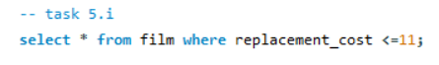
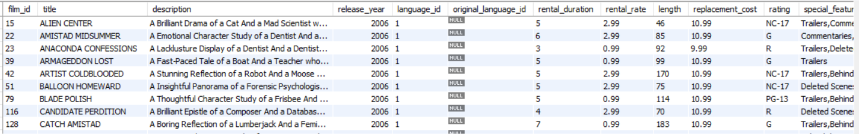
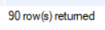
Result :
There are 90 movies which has replacement cost up to $11.

Slide 11
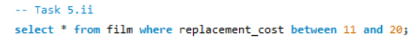
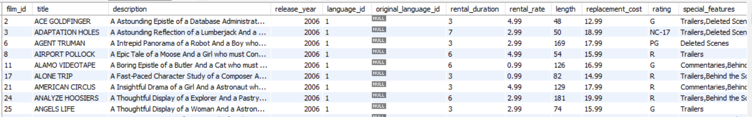
Result :
There are 425 movies which have replacement cost between $11 to $20.

Slide 12
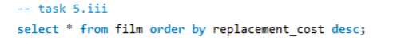
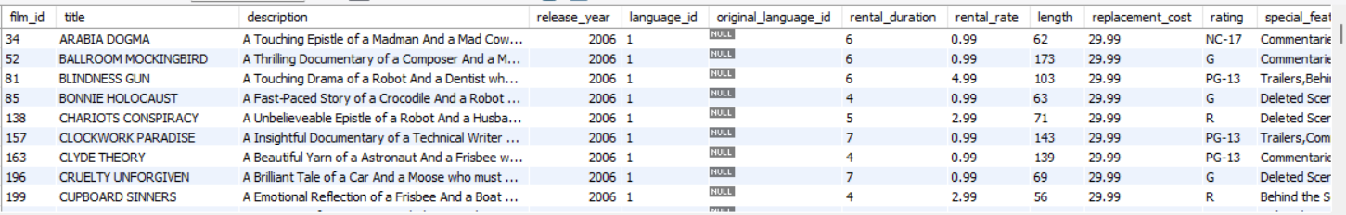
Result :

Slide 13
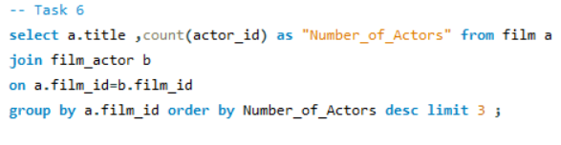
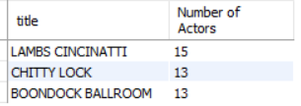

Result :
Lambs Cincinatti, Chitty Lock and Boondock Ballrool are top 3 movies with the greatest number of actors.

Slide 14

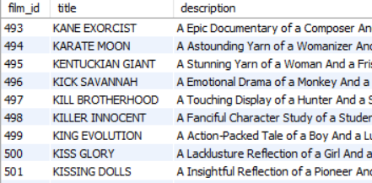

Result :
There are total 15 movies whose names are starting with “K” or “Q”, where starting with “K” is 12 movies and 3 movies with starting “Q”

Slide 15

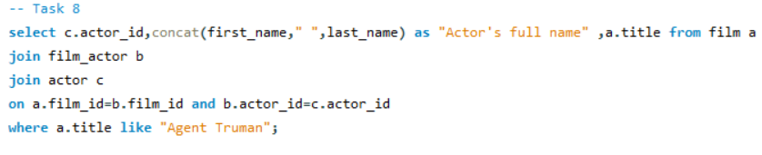
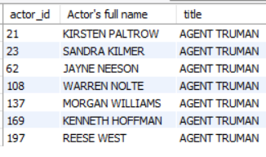
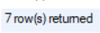
Result :
7 actors worked in the movie Agent Truman.

Slide 16

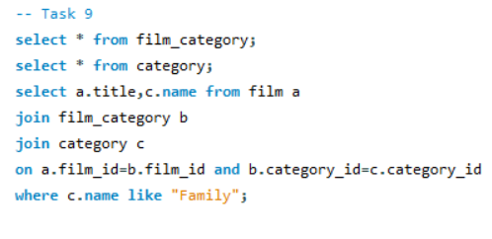

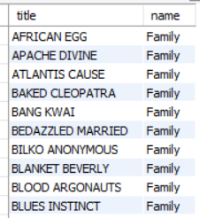
There are 69 movies which can be considered as family category.
Result :

Slide 17
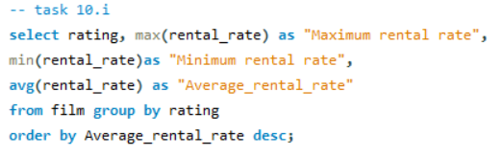
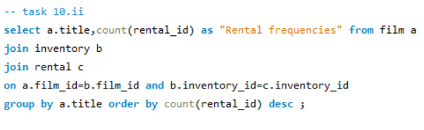

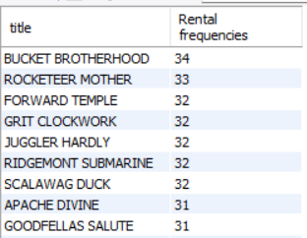
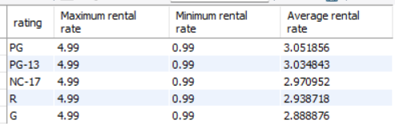
Result :
Result :
PG has highest average rental rates
G has lowest average rental rates
Bucket Brotherhood is the movie with highest time rented.

Slide 18
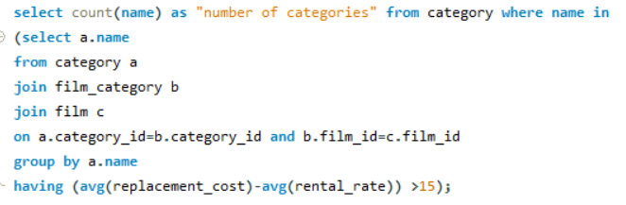
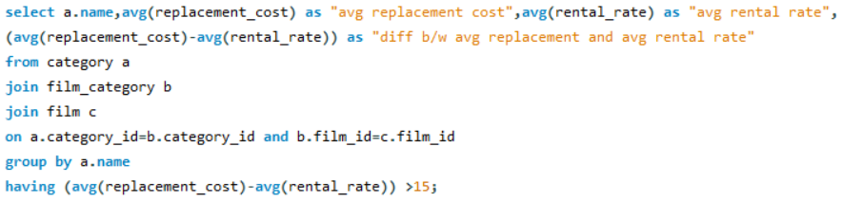

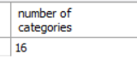
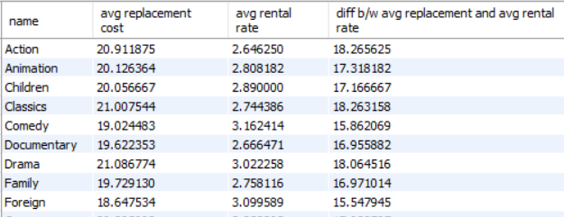
Result :
Result :
There are 16 categories of movie where difference between average replacement cost and average film rental rate is more than 15.

Slide 19
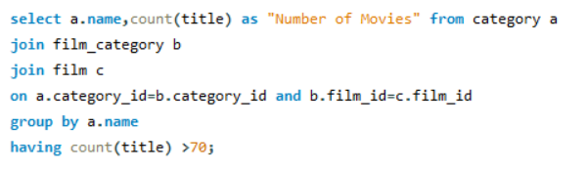

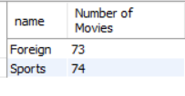

Result :
Foreign and Sports are the only two category which have movies more than 70.

Slide 20
conclusion
The purpose of this research was to identify effective strategies for dealing with repetitive best movies and its genre in the market.
Based on the analysis conveyed, it can be concluded that there are multiple types of movie which have rented more than 25 times , so that management should be aware of that and keep more copies of that film.
Foreign and sports movie categories have more than 70 different movies , so management should also focus on that categories.
We should be focus on the actors who worked in AGENT TRUMAN , because the movie was blockbuster.

Slide 21

Thank you

